Slide 1
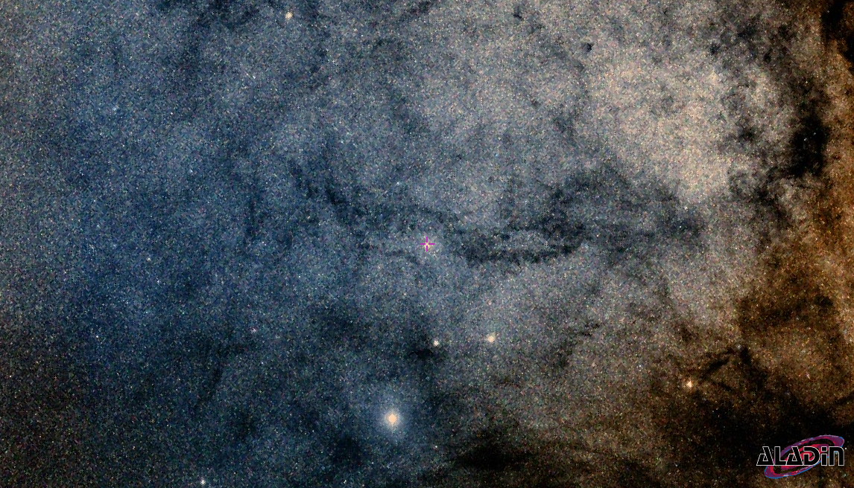
Reddening, Distance and Luminosities of a new sample of Galactic Cepheids for probing the Milky Way and calibrating the extra-galactic distance scale
Shubham Mamgain
Master Thesis Defense Supervisor I : Dr. Jesper Storm Supervisor I : Prof. Dr. Maria Rosa Cioni

Slide 2
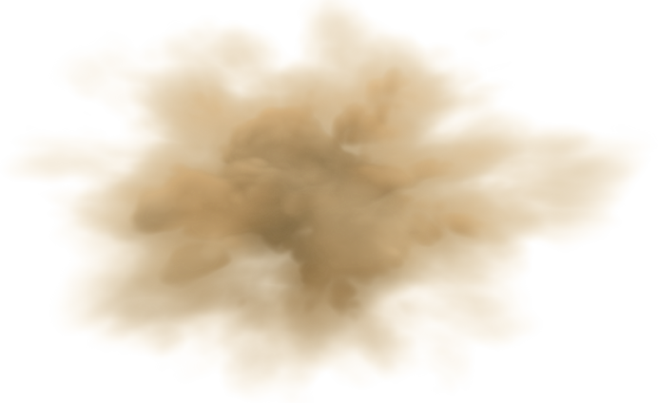

Reddening - Distance - Luminosity
dL : Distance (in parsec)
10 pc
0 pc
δdλ
µL : Distance Modulus (in magnitude)
0 mag
µ
δµλ
Color Excess
E(B-V)
Rλ
Absolute
Reddening Ratio
True Position
Apparent
Absolute
Distance
µ
True
Extinction
mλ
Mλ⁰
Aλ
Mλ

Slide 3
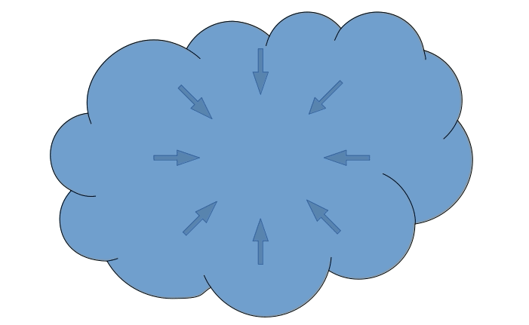
Star Formation

Slide 4
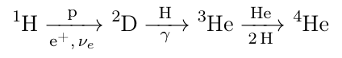
Introduction – Main Sequence Star
Core Temperature > 10 MK - Nucleosynthesis
High Velocity of Particles
Overcome electrostatic repulsion
Nuclear Fusion energy halts gravitational collapse
Thermal electromagnetic radiation
Luminosity is proportion to the mass

Slide 5
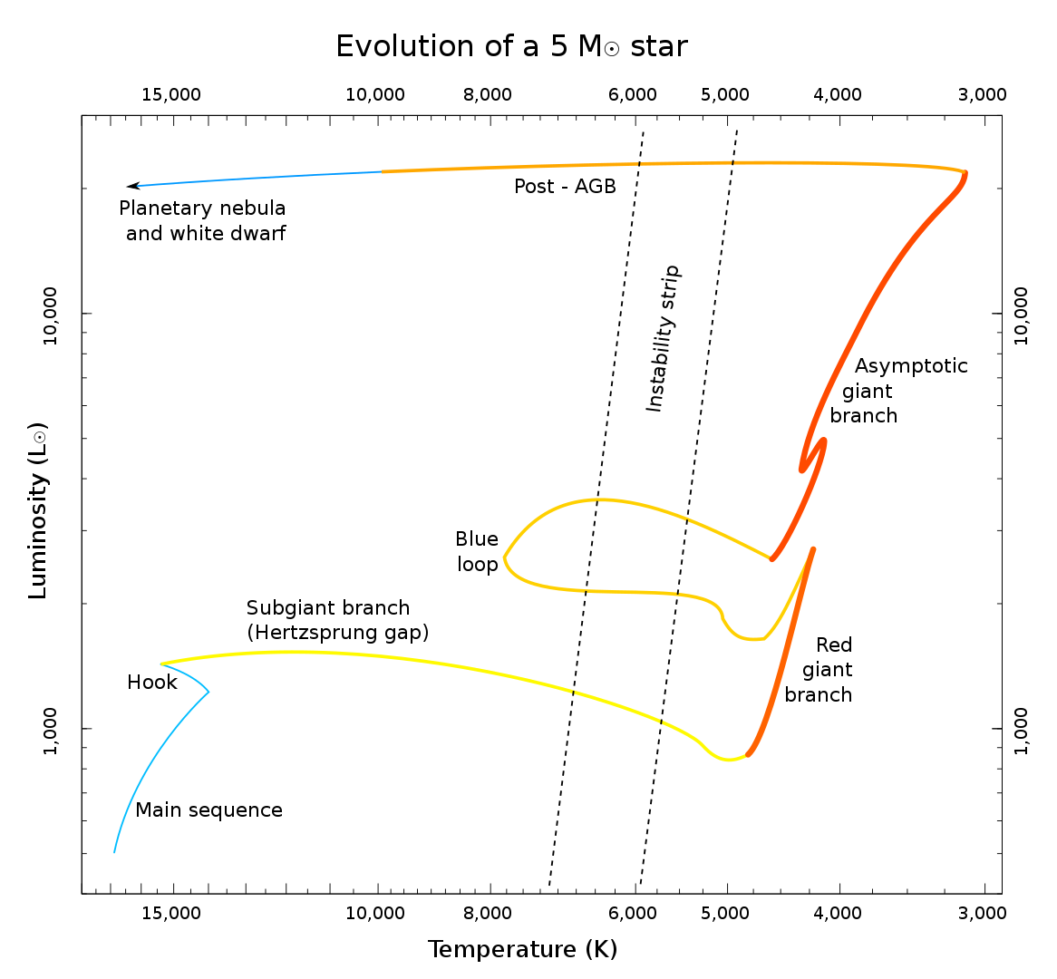

Slide 10
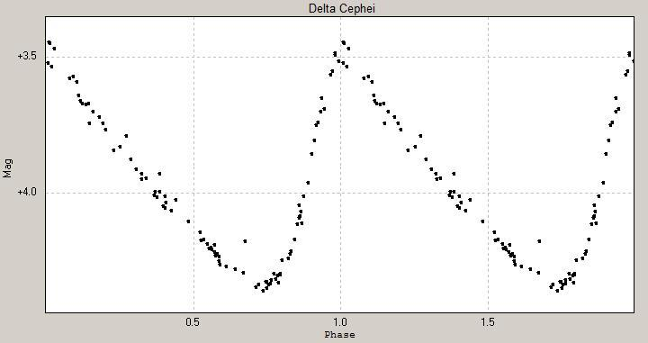
Pulsation of Cepheid

Slide 11
Pulsation of Cepheid

Slide 12
Pulsation of Cepheid

Slide 13
Pulsation of Cepheid

Slide 14
Pulsation of Cepheid

Slide 15
Pulsation of Cepheid

Slide 16
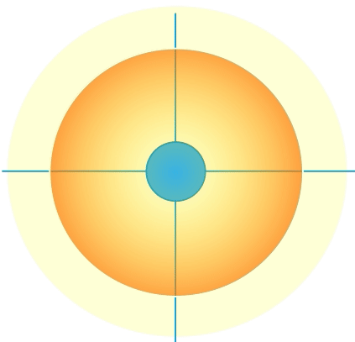
Pulsation of Cepheid

Slide 17
Pulsation of Cepheid

Slide 18
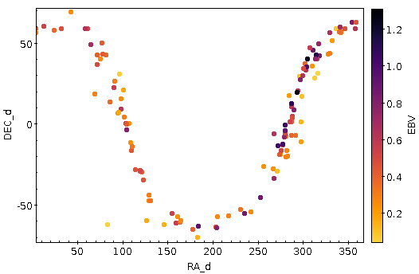
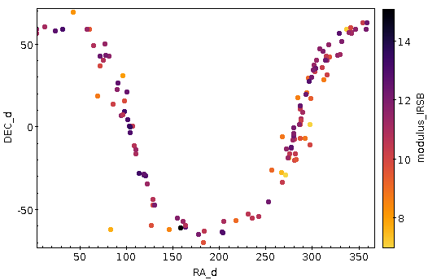
Cepheid Sample
MW - 150
OT - 21

Slide 19
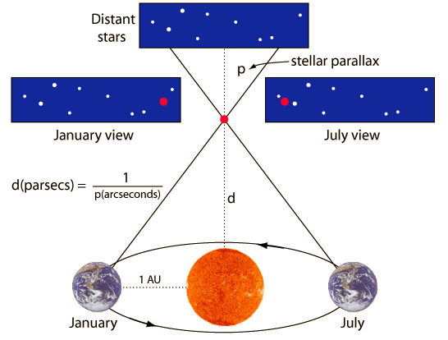
Distance Determination of Galactic Cepheid
IRSB
Parallax

Slide 20
Luminosity
L = σ AT⁴

Slide 21
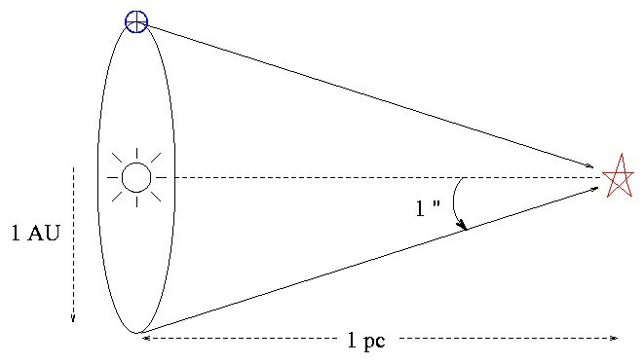
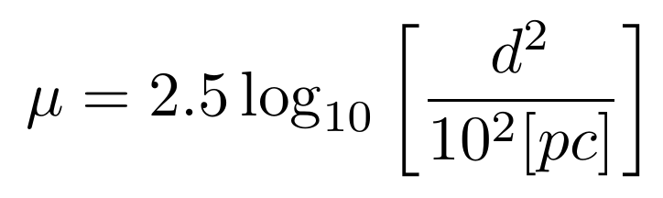
Distance - Luminosity
Distance (parsec)
10 pc
0 pc
Distance modulus (magnitude)
0 mag

Slide 22
Distance - Luminosity
d
10 pc
0 pc
µ
0 mag
mλ⁰
Mλ⁰

Slide 23
d
10 pc
0 pc
d’
µ
0 mag
µ’
Reddening due to absorption of light
mλ
Mλ⁰
Mλ
Aλ

Slide 24
Reddening - Distance - Luminosity
d : Distance (in parsec)
10 pc
0 pc
d’
µ : Distance Modulus (in magnitude)
0 mag
µ’
Interstellar dust
Rλ
Absolute
True Position
Extinction
Apparent
Absolute
Distance
µ
True
Color Excess
E(B-V)
mλ
Mλ⁰
Mλ
Aλ
Aλ = Mλ - M⁰λ
= mλ– m⁰λ
= Rλ E(B-V)

Slide 25
Reddening - Distance - Luminosity
10 pc
0 mag
µ µλ’
←δμλ→
mλ (Apparent magnitude) = Aλ (Extinction) + µ (Modulus) + Mλ⁰ (True Absolute)

Slide 26
Mλ
M⁰λ
Absolute Magnitude
True Absolute Magnitude
mλ
µ
Aλ
Apparent Magnitude
Distance Modulus
Extinction
Luminosity
Distance
Reddening
mλ (Apparent magnitude) - µ (Modulus) - Aλ (Extinction) = Mλ⁰ (True Absolute)

Slide 27
Reddening-free Magnitude
Rλ
W
W⁰

Slide 28
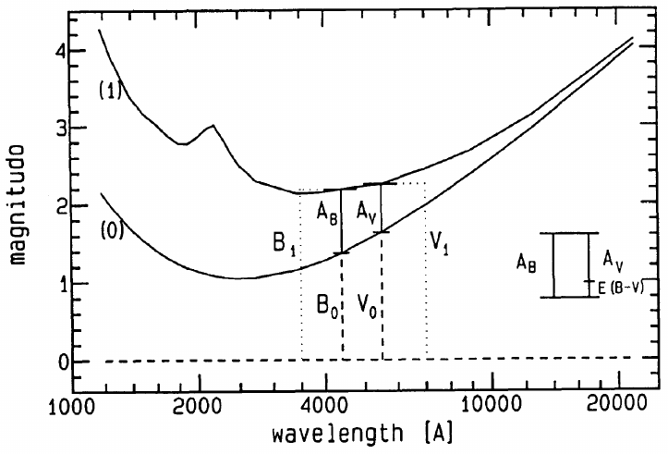
Reddening-free Magnitude
Visual Band
Blue Band
E(B-V) = AB - AV
E(B-V) = AB - AV
AV / E(B-V) = RV
= +

Slide 29
Reddening-free Magnitude

Slide 30
Galactic Cepheid

Slide 31
Galactic Cepheid Sample

Slide 33
PW
(Δ-Δ)λ
logP
(PL)λ

Slide 34
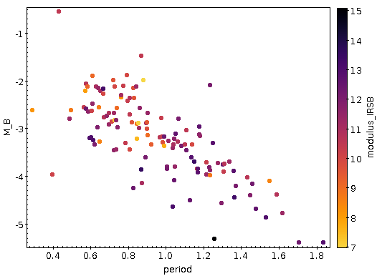
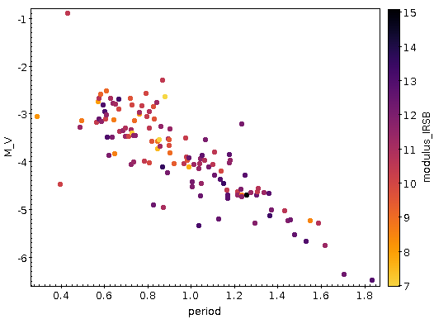
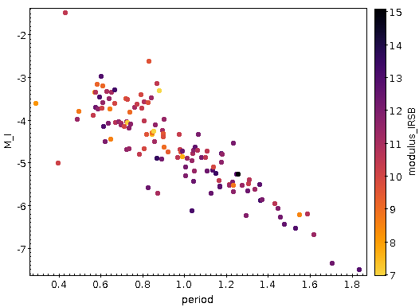



Period Luminosity Relation
Period-Luminosity

Slide 35
From all Cepheids
B
V
I
J
δAλ
H
Slope = αλ
K
ΔΜ
ΔMλ
ΔW
ΔW

Slide 36
δA^{i}λ

Slide 37
Possible correction in extinction for given modulus:
δAλ
Slope = αλ
δAλ = Δm – αλ(ΔW)
Δm
What if distance modulus require correction?
ΔW

Slide 38
δμ⁴
Slope = 1
Let there is δμ correction required in modulus, then
δμ³
m = M0 + µ + δμ + Aλ + δAλ
δμ²
Slope = αλ
δμ¹
W = M + RV (B - V) + µ + δμ
Deviation from PL relation
Apparent mag is sensitive to reddening and modulus, however, Wesenheit mag is sensitive to modulus only.
δμ⁴
δμ²
δμ¹
δμ³
Deviation from PW relation
Implies, star will shift in the line of slope 1 for modulus adjustment

Slide 39
B
V
I
J
H
K
ΔMλ
ΔW

Slide 40
For each Cepheid
δAλ / Rλ
RMS
δμ
δμ

Slide 41
B
V
δμ⁴
Slope = 1
a)
δμ³
b)
I
c)
J
δμ²
H
K
δμ¹
δAλ⁴
δAλ³
δE(B-V) = δAλ / Rλ
δΕ rms
Deviation from PL relation
δAλ
δAλ²
δAλ¹
Suggested modulus correction
Deviation from PW relation
Adjustment in modulus, δμ
δμ
Adjustments in µ lead to corrections in extinction
Resulting δE for δµ in all bands
Least rms in δE yields µ correction

Slide 42
M⁰λ
(δμ, δEBV)

Slide 43
Calibration procedure
IV
B
V
I
J
II
From all Cepheids
δAλ
H
Rλ
Slope = αλ
ΔMλ
K
PW
ΔΜ
W
W⁰
ΔW
(Δ-Δ)λ
ΔW
III
logP
V
(PL)λ
I
Mλ
M⁰λ
For each Cepheid
δAλ / Rλ
RMS
mλ
µ
Aλ
VI
δμ
δμ
M⁰λ
(δμ, δEBV)

Slide 44
Resource
Slide Number | Content | Source
2 | Light Curve | ThomasK Vbg, wikipedia
29 | Blackbody curve | 1993 The Interstellar Extinction Curve

Slide 45
Star Formation
Local minima of spacetime curvature

Slide 46
Star Formation
Local minima of spacetime curvature
Gravitation collapse of (molecular) gas cloud

Slide 47
Star Formation
Local minima of spacetime curvature
Gravitation collapse of (molecular) gas cloud
Protostar core getting denser and warmer

Slide 48
Star Formation
Local minima of spacetime curvature
Gravitation collapse of (molecular) gas cloud
Protostar disk forms, denser and warmer
Temperature: 100-10,000 K

Slide 49
Astronomical Standards
Sun as a standard star :
Luminosity 1 M
Mass 1 M
Radius 1 R
Distance 1 AU
Metallicity 1 [Fe/H]
Sun-type Star

